Slide 1
Data Analysis
E-retail factors for customer activation and retention

Slide 2
Problem Statement
Customer activation and retention will play a key role to develop the business. Today here we are going to check what factors help customer retention for online purchases.
The data is collected from Indian online shoppers.

Slide 3
Skills Used
The language used for this project is Python.
Libraries required for this project are Pandas, Numpy, Matplotlib, Seaborn.

Slide 4
Data Set
While doing the data science project first thing is we have to load the data set, this can be done with Pandas.read_csv()
The data set contains 71 columns and 269 rows.

Slide 5
Data Set
The data set contains 70 categorical data and one numerical data.
There are no null values in the given data set.

Slide 6
Statistics
With the help of pandas. describe () function we can get mean, median, min and max value for numerical column and for categorical data we can get information of a number of unique values, most occurred frequency value and frequency.

Slide 7
Statistics
Only one column is numerical which is also Pincode. So there is no use of statistics for these columns. So, we drop the column, because we already have a column with the city names.
From the categorical data, we can see which are the most frequently occurred values and frequency. We can see that in the next slide.

Slide 8
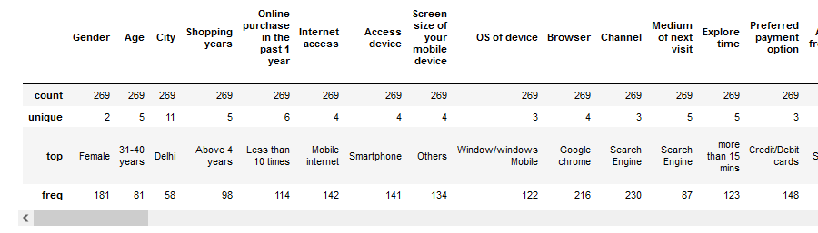
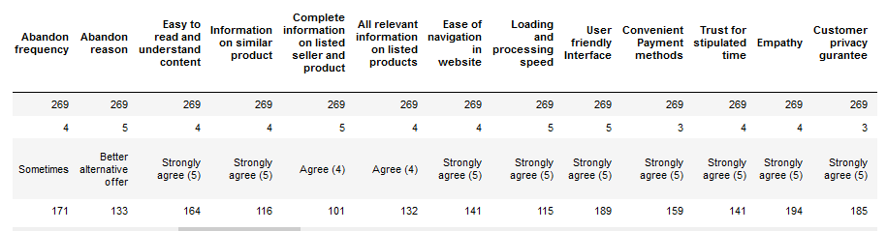
Statistics

Slide 9
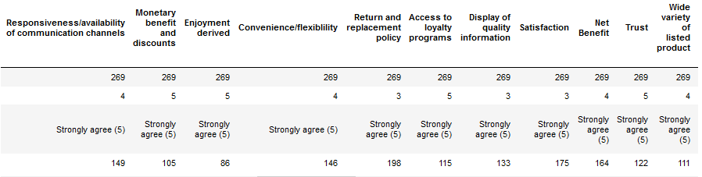
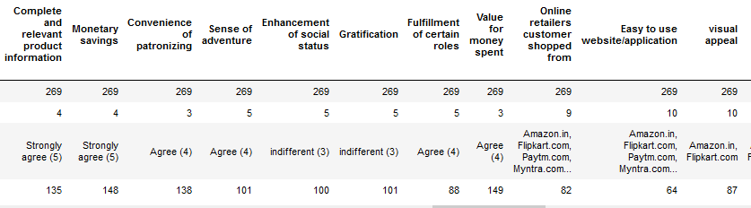
Statistics

Slide 10
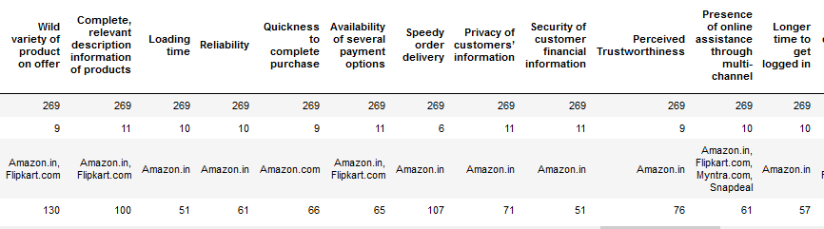
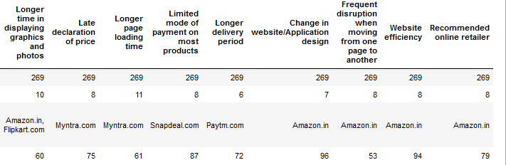
Statistics

Slide 11
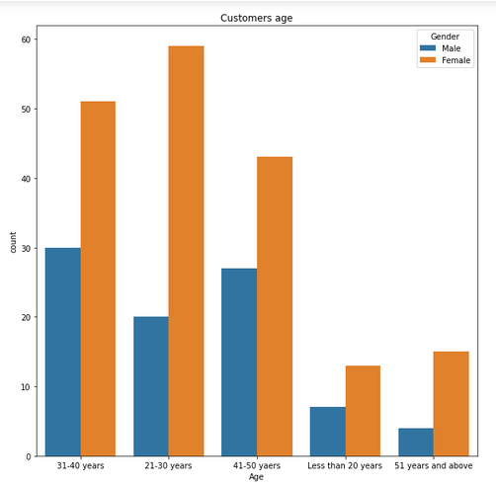
Visualization
Age group of customers.

Slide 12
Age group of customers.
The graph shows that most Females from the age of 21 - 50 years and Males from the age group of 31 – 50 years like to do online shopping.

Slide 13
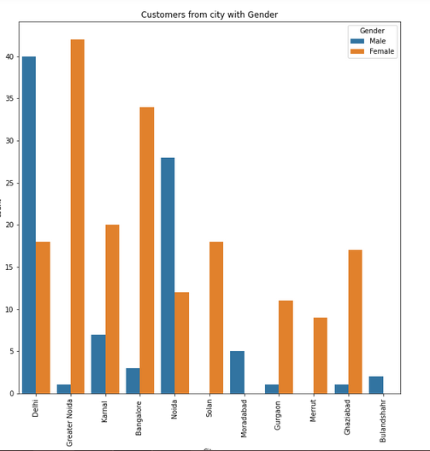
Customers from which city
Majority customers from the cities :
21% - Delhi
15% - Grater Noida
14% - Noida
13% - Bangalore
Male customers from "Delhi and Noida" and Female customers from "Greater Noida and Bangalore “ are much interested in online shopping.

Slide 14
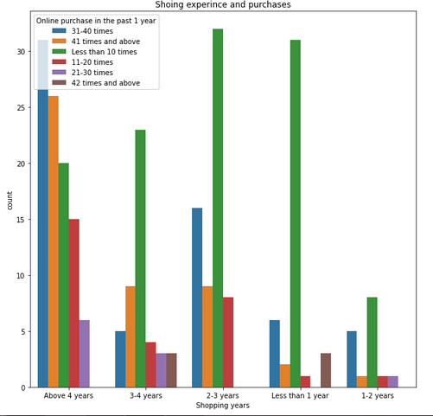
Customer Shopping Experience
The graph, it shows that many customers who have "above 4 years" of shopping experience made more purchases when compared to the customers who have equal or below 4 years of shopping experience.

Slide 15
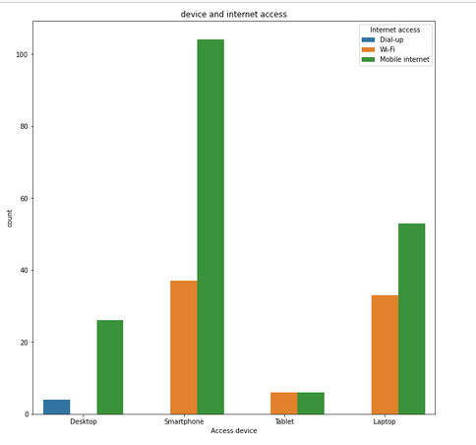
Source to online shopping
Customers are mostly interested to use Smartphones and Laptops with Mobile Internet to get access to online shopping. It looks customers feel it is safe to use their own mobile data for online purchases instead of using any public or other wifi options.

Slide 16
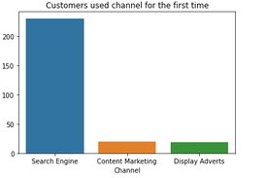
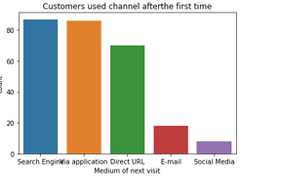
Channel Used for Online purchase.
The first graph shows that when customers visit for the first time for online purchase, 85% of the customers use the Search engine for online purchase and the remaining percentage of customers used the "content marketing and display adverts" channel. When you see the second map most of the customers after the first purchase chooses different channels like Via Application. Direct URL, Email and Social media

Slide 17
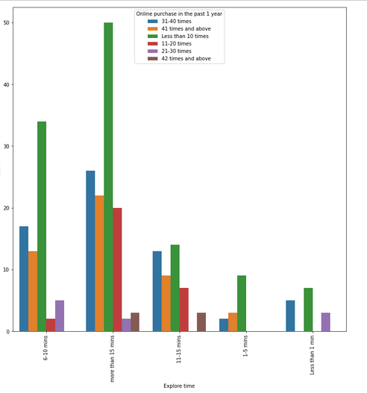
Time spent for shopping.
Customers who spent more than 15 minutes have made more purchases when compared to customers who spent less time.

Slide 18
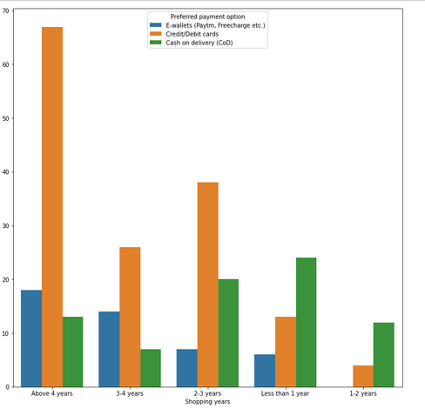
Payment used.
Here, we can see that as the years of shopping experience increase customers using E-wallet and credit/debit card payment increased and cash on delivery payment decreased.

Slide 19
Survey
In the given data from column "Easy to read and understand the content" to the column "Value for money spent" contains customer feedback for the website content, trust/loyalty, satisfaction, empathy, website payment security, online purchase convenience, monetary benefits (promo, gift card), Value for money. There are nearly 24 columns with the same data
These columns have data of ratings like:
**Strongly agree (5)
**Agree (4)
**indifferent (3)
**Dis-agree (2)
**Strongly disagree (1)

Slide 20
Survey
Since all the columns have the same type of data. So here, I've separated these columns from the given data frame and created a new data frame.
with each customer survey on all these columns, I'm going to check the most frequently rated (mode/average) value and will build a separate column for that most frequently rated value. This helped me to check the customer rating for the whole online purchase experience.
I converted the values "Strongly agree (5) and Agree (4)" as customer “good” satisfaction, indifferent as "neutral" and "Dis-agree and Strongly disagree (1)" as “bad” satisfaction.

Slide 21
Survey
The output I got from this is 93.3% of customers provided positive survey whereas 6.69% of customers provided negative survey.
I took "Gender", "Age", "City", "Shopping Years", "payment mode used", "Abandon frequency" of the customers and check with the average survey to see who provided good and bad ratings.

Slide 22
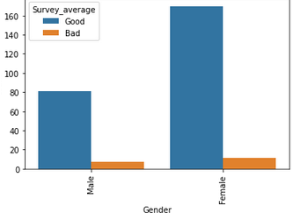
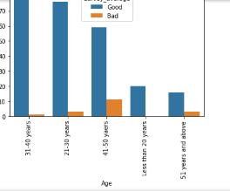
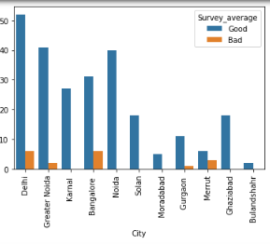
Survey visualization

Slide 23
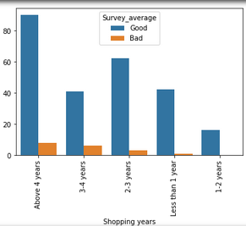
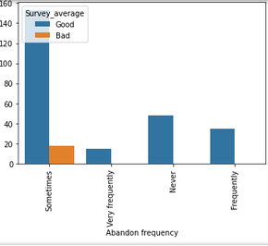
Survey visualization

Slide 24
Survey visualization observations:
Customers who provided bad ratings:
**Female Customers
**Customers with age 41-50 years
**Customers from Delhi and Bangalore cities
**Customers who have above 4 years shopping experience
**Customers who use credit/debit cards
**Customers whose Abandon Frequency is Sometimes

Slide 25
,
The remaining data contains where customers selected which e-commerce website is providing both positive and negative experiences in different scenarios.

Slide 26
,
I applied value_counts for the remaining data where the columns contain website names. From this, I created a table as a primary and secondary preferable website as per the scenario.

Slide 27
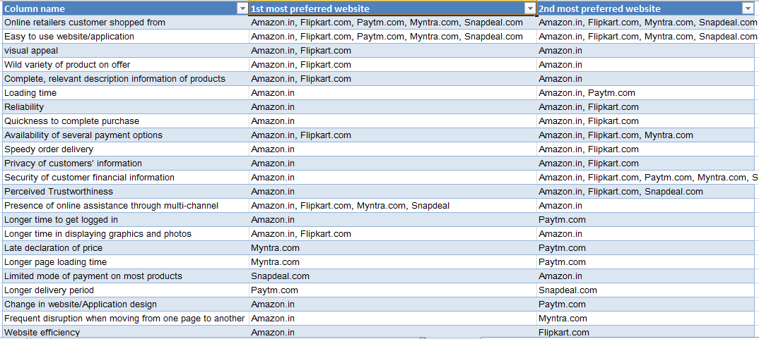

Slide 28
Conclusion
From the table, we can see that customers preferred mostly Amazon.in and next Flipkart.com in positive scenarios. When you see the red box in the table the content in that red box contains negative scenarios and for these scenarios, customers selected Myntra.com, Paytm.com, Snapdeal.
From this, we came to know that customers are most interested to stay with Amazon. in and Flipkart.com also existing customers recommended these websites for new customers.

